Slide 1
EXCEPTION

Slide 2
Agenda
Errors vs Exceptions
Exception inheritance tree
List of standart exception
Handling exceptions
Handling many exceptions
Raising Exceptions
Logging

Slide 3
Errors vs Exceptions
There are (at least) two distinguishable kinds of errors:
syntax errors and logical errors (exceptions).
The first type is syntax error. They result from a violation of the programming language syntax when writing source code. If there are such errors, the program cannot be compiled. When working in any development environment, for example, in PyCharm, the IDE itself can track syntax errors and allocate them in some way.
The second type of errors are runtime errors. They appear in the already compiled program during its execution. Such errors are also called exceptions. When that error occurs, Python generate an exception that can be handled, which avoids your program to crash.

Slide 4
Errors vs Exceptions
Syntax errors occur when the parser detects an incorrect statement.
>>> print( 0 / 0 ))
File “<stdin>”, line 1
print( 0 / 0 ))
^
SyntaxError: invalid syntax
An exception is an error that happens during execution of a program. When that error occurs, a Python script raises exception (it creates an Exception object) that can be handled, which avoids your program to crash.
>>> print( 0 / 0)
Traceback (most recent call last):
File “<stdin>”, line 1, in <module>
ZeroDivisionError: integer division or modulo by zero

Slide 5
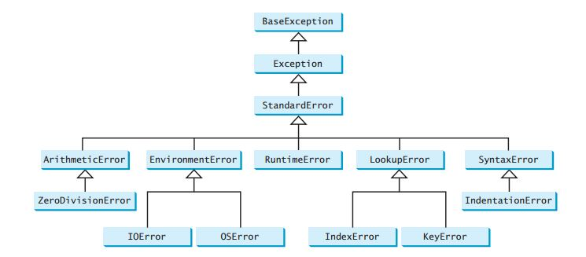
Exception inheritance tree

Slide 6
List of System & Standard Exceptions
BaseException The base class for all built-in exceptions. It is not meant to be directly inherited by user-defined classes.
SystemExit Raised by the sys.exit() function.
KeyboardInterrupt Raised when the user interrupts program execution, usually by pressing Ctrl+С.
GeneratorExit Raised when a generator is closed (with the close() method)
Exception All built-in, non-system-exiting exceptions are derived from this class. All user-defined exceptions should also be derived from this class.
ArithmeticError The base class for those built-in exceptions that are raised for various arithmetic errors.
ZeroDivisionError Raised when division or modulo by zero takes place for all numeric types.
IndexError Raised when an index is not found in a sequence.
KeyError Raised when the specified key is not found in the dictionary.

Slide 7
List of Standard Exceptions
NameError Raised when an identifier is not found in the local or global namespace.
TypeError Raised when an operation or function is attempted that is invalid for he specified data type.
ValueError Raised when the built-in function for a data type has the valid type of arguments, but the arguments have invalid values specified.
AttributeError Raised in case of failure of attribute reference or assignment.
IdentationError Raised when identation is not correct.
StopIteration Raised when the next() method of an iterator does not point to any object.
SyntaxError Raised when a syntax error is encountered by the parser.
ImportError Raised when python cannot find the module.
EOFError Raised when one of the built-in functions (input() or raw_input()) hits an end-of-file condition (EOF) without reading any data.
IOError Raised when an input/ output operation fails, such as the print statement or the open() function when trying to open a file that does not exist.

Slide 8
List of Standard Exceptions
>>> 8 * (17/0)
Traceback (most recent call last):
File, line 1, in <module>
ZeroDivisionError: division by zero
>>> 6 + value*2
Traceback (most recent call last):
File, line 1, in <module>
NameError: name 'value' is not defined
>>> '5' + 5
Traceback (most recent call last):
File, line 1, in <module>
TypeError: Can't convert 'int' object tompl
Ic
itly
>>> abc = { 'a':1, 'b':2 }
>>> abc['c']
Traceback (most recent call last):
File, line 1, in <module>
KeyError: 'c'

Slide 9
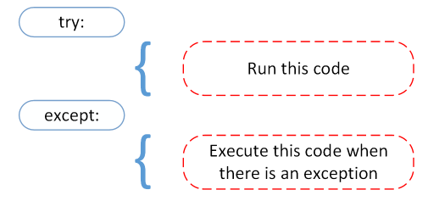
Handling Exceptions
Exceptions should be class objects. The exceptions are defined in the module “exceptions”. This module never needs to be imported explicitly: the exceptions are provided in the built-in namespace as well as the exceptions module.
One can catch exception with the help of "try...except", which have the following syntax:
a = [5, 6, 7,8]
try:
print("Second element = {}".format(a[1]))
# Throws error since there are only 4 elements in array
print("Fifth element = {}".format(a[4]))
except IndexError as e:
print(e)

Slide 10
Handling Many Exceptions
# Program to handle multiple errors with one except statement
try:
a = int(input("Enter your number: "))
if a < 4:
b = a/(a-3) # throws ZeroDivisionError for a = 3
if a >= 4:
print("Value of b = ", b) # throws NameError
# note that braces () are necessary here for multiple exceptions
except(ZeroDivisionError, NameError, ValueError):
print("Error Occurred and Handled"))

Slide 11
Handling Many Exceptions
# Program to handle multiple errors with one except statement
try:
a = int(input("Enter your number: "))
if a < 4:
b = a/(a-3) # throws ZeroDivisionError for a = 3
if a >= 4:
print("Value of b = ", b) # throws NameError
# note that braces () are necessary here for multiple exceptions
except ValueError:
print("Value Error!")
except NameError:
print("NameError!))
except ZeroDivisionError:
print("ZeroDivisionError!")
except:
print("Error!")
)

Slide 12
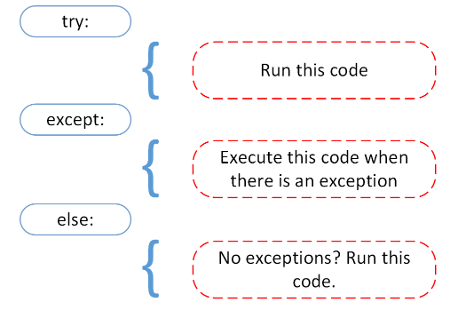
Handling Exceptions
We can use the else keyword to define a block of code to be executed if no errors were raised:
try:
f = open("newfile.txt")
f.write("Second element: ")
except:
print("Something went wrong when writing to the file")
else:
print("Nothing went wrong")

Slide 13
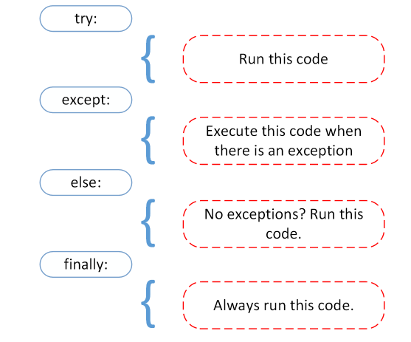
Handling Exceptions
The finally block, if specified, will be executed regardless if the try block raises an error or not:
try:
f = open("newfile.txt")
f.write("Second element: ")
except:
print("Something went wrong when writing to the file")
else:
print("Nothing went wrong")
finaly:
f.close()
print("The 'try except' is finished")

Slide 14
Raising Exceptions
In Python programming, exceptions are raised when corresponding errors occur at run time, but we can forcefully raise it using the keyword raise.
The raise statement allows the programmer to force a specific exception to occur. The sole argument in raise indicates the exception to be raised. This must be either an exception instance or an exception class (a class that derives from Exception).
try:
value = int(input("Enter a positive integer: "))
if value <= 0:
raise ValueError("That is not a positive number!")
except ValueError as e:
print(e)

Slide 15
Custom exception class
class CustomError(Exception):
def __init__(self, data):
self.data = data
def __str__(self):
return repr(self.data)
try:
num_of_group = int(input("Enter number of your group: "))
if num_of_group < 1:
raise CustomError("Number of your group can't be less than 1")
except CustomError as e:
print("We obtain error:", e.data)

Slide 16
Useful Link
Built-in Exceptions
https://docs.python.org/3/library/exceptions.html
Logging
https://docs.python.org/3/library/logging.html
Notes:
Ось перелік посилань на документацію по даній тематиці.

